Slide 1
MODULE – 1
Multithreading in Java

Slide 2
Contents
Module1: Multi-Threading in Java:
Understanding Threads , Needs of Multi-Threaded Programming
Creating a Thread
Thread Life-Cycle
Thread Priorities
Synchronizing Threads
Inter Communication of Threads
Deadlock and Concurrency Framework

Slide 3
Session 1: Understanding Threads , Needs of Multi-Threaded Programming

Slide 4
Introduction to Multithreading :
Multithreading enables a Java program to execute multiple tasks concurrently by dividing the program into smaller units called threads.
Each thread runs independently but shares the same memory space. With multithreading it improves CPU utilization, application responsiveness, and overall performance, especially on multi-core systems.
Example (Single task vs Multithreaded task)
Instead of downloading a file and playing music sequentially, a multithreaded program can perform both operations simultaneously using separate threads.

Slide 5
Thread vs Process
A process is a program in execution.
A thread is a lightweight sub-process.
Multiple threads can exist within the same process.
Threads share:
  Code
  Data
  Files
Each thread has its own:
  Program counter
  Stack
  Local variables

Slide 6
Advantages of Multithreading
Efficient CPU Utilization
Multithreading enables better utilization of CPU resources by allowing multiple tasks to execute concurrently, reducing idle time of the processor.
Improved Application Performance
Programs can complete tasks faster as multiple threads perform different parts of a task simultaneously, especially on multi-core systems.
Enhanced Responsiveness
User interfaces remain responsive because time-consuming tasks can run in background threads without blocking the main thread.
Resource Sharing
Threads share the same memory space and resources, which reduces memory overhead and allows faster communication between threads.
Reduced Context Switching Cost
Context switching between threads is faster and less expensive compared to switching between processes.

Slide 7
Scalability
Multithreaded applications can easily scale to utilize multiple processors or cores, improving throughput.
Better Throughput
Multiple threads can handle multiple requests concurrently, making multithreading ideal for server and network applications.
Simplified Program Structure for Concurrent Tasks
Complex tasks can be logically divided into smaller, manageable threads, improving program design and maintainability.
Effective Use in Real-Time Applications
Multithreading supports real-time and interactive applications where tasks must be performed within strict time constraints.
Background Task Handling
Time-consuming operations such as file I/O, network communication, and database access can run in background threads without affecting foreground tasks.

Slide 8
Threads Concept
Multiple threads on multiple CPUs
Multiple threads sharing a single CPU

Slide 9
Java Thread Model
Java follows a thread-based multitasking model rather than process-based multitasking. In this model, multiple threads run concurrently within the same program.
Java uses a preemptive, priority-based scheduling mechanism, where higher-priority threads are generally executed before lower-priority ones.
The actual scheduling behavior depends on the JVM and underlying operating system. Java threads are implemented using native OS threads, ensuring better performance and portability across platforms.

Slide 10
Understanding main Thread:
What is the Main Thread?
When a Java program starts, the Java Virtual Machine (JVM) automatically creates one thread.
This thread is called the main thread.
The main thread executes the main() method.
It is the first thread to begin execution.
All other threads are created from the main thread.
The life cycle of the program is controlled by the main thread(also called as Parent thread).

Slide 11
Main Thread Program (Example):
class MainThreadDemo {
public static void main(String[] args) {
Thread t = Thread.currentThread();
System.out.println("Current thread: " + t);
}
}
Output:
Thread[main,5,main]

Slide 12
Meaning of the output:
main
Name of the thread.
Default name given by JVM to the main thread.
5
Thread priority.
Default priority is NORM_PRIORITY = 5.
main
Name of the thread group.
By default, the main thread belongs to the "main" thread group.

Slide 13
Modifying the Main Thread
Changing Main Thread Name:
class MainThreadModify {
public static void main(String[] args) {
Thread t = Thread.currentThread();
t.setName("MyMainThread");
System.out.println("After change: " + t);
}
}
Output:
After change: Thread[MyMainThread,5,main]

Slide 14
Thread Priorities:
Each Java thread is assigned a priority that influences the order of execution. Priorities range from 1 (minimum) to 10 (maximum), with 5 as normal priority.
Higher priority threads are given preference by the scheduler, but priority does not guarantee execution order. The thread priority behavior is platform-dependent and should not be relied upon for program correctness.
Synchronization:
Synchronization is used to prevent thread interference and data inconsistency when multiple threads access shared resources.
Java uses the synchronized keyword to enforce mutual exclusion, ensuring that only one thread accesses a critical section at a time.
Synchronization can be applied to methods or specific code blocks. While synchronization ensures correctness and excessive synchronization can reduce performance due to thread blocking.

Slide 15
Session 2: Creating a Thread and Thread Life Cycle

Slide 16
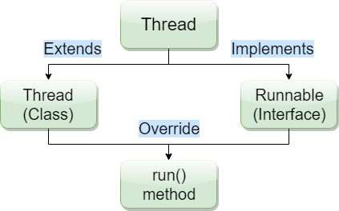
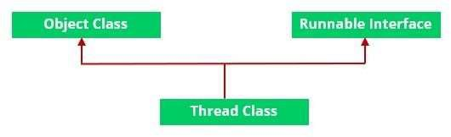
Multithreading
Threads can be created by using two mechanisms: Method 1. Extending the Thread class
Method 2. Implementing the Runnable Interface

Slide 17
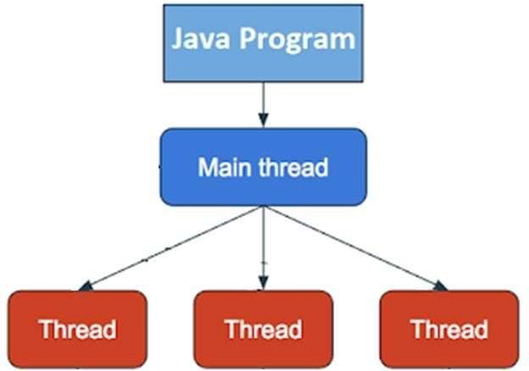
Multithreading
When a Java program starts, one thread known as main thread is created, which executed code written inside the main method, if you create a thread, then those threads are created and started by the main thread, once started they start executing code written in their run() method.
Three different kinds of issues:
Issues, which always comes
Issues, which comes only sometimes, but consistent with the same input
Issues, which is truly random

Slide 18
Method 1. Thread Class
Method 2. Runnable Interface
Thread class
Runnable
Sample Class
Sample Class
Thread Class vs Runnable Interface
If we extend the Thread class, our class cannot extend any other class because Java doesn’t support multiple inheritance. But, if we implement the Runnable interface, our class can still extend other base classes.
We can achieve basic functionality of a thread by extending Thread class because it provides some inbuilt methods like yield(), interrupt() etc. that are not available in Runnable interface.

Slide 19
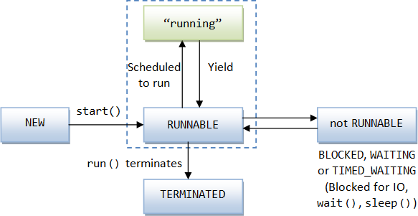
Life cycle of a Thread (Thread States)
According to sun, there is only 4 states in thread life cycle in java
  New,
  Runnable,
  Not-runnable and
  Terminated.
There is no running state.
threadStates.java

Slide 20
Life cycle of a Thread (Thread States): The Thread Class and Methods
yield(), or time out
Running
run() returns
Thread created
start()
New
Ready
run()
join()
Terminated
interrupt()
sleep()
Target finished
wait()
Wait for target to finish
Wait for time out
Time out
Wait to be notified
notify() or notifyAll()
Blocked
Interrupted()

Slide 21
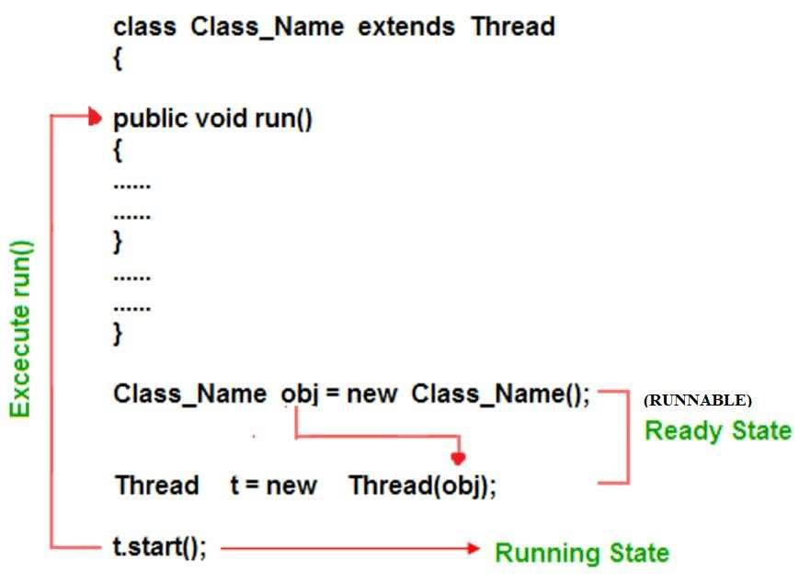
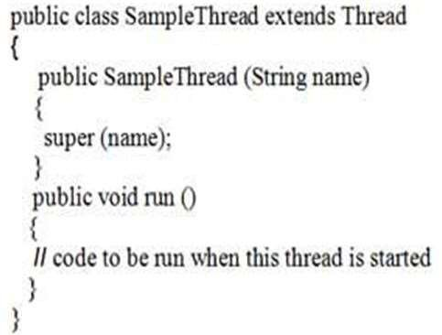
Thread
Method 1. Syntax:
extends
Sample
Example:

Slide 22
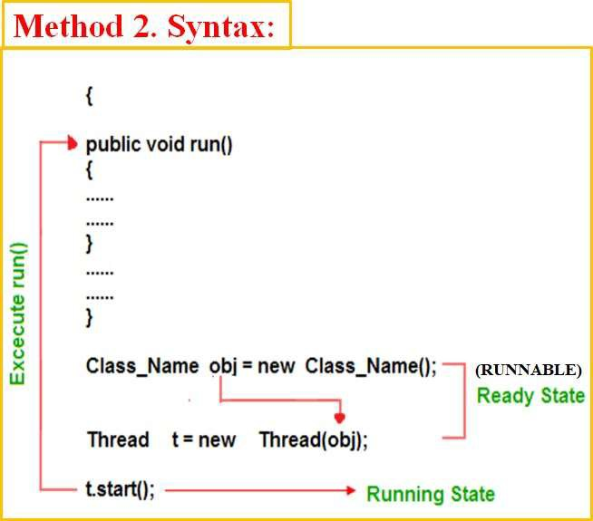
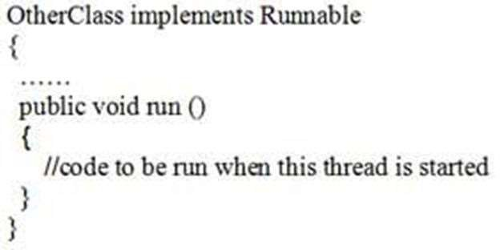
Runnable
implements
Class Class_Name Implements
OtherClas
Example:

Slide 23
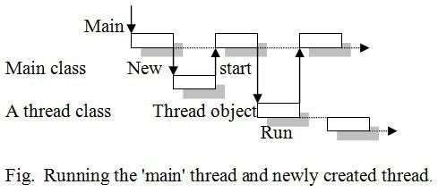
Example: thread1.java
Thread
//Program Using extends to write a single-thread program. import java.lang.*;
class ThreadExample extends Thread { public ThreadExample (String name) {
extends
ThreadExample
super (name);
}
public void run () {
System.out.println (Thread.currentThread ()); For (int i=0; i<=5; i++)
System.out.println (i);
}
}
public class thread1 {
public static void main (String args [ ]) { ThreadExample obj = new ThreadExample ("First"); obj.start ( );
System.out.println (''This is:" + Thread.currentThread ());
OUTPUT:
This is: Thread [main, 5, main]
Thread [First, 5, main]
}
}

Slide 24
Example: thread2.java
Runnable
//Program illustrates the creation of threads using Runnable interface.
class ThreadExample implements Runnable { Thread t;
implements
ThreadExample
public ThreadExample (String ThreadName) { t = new Thread (this, ThreadName);
}
public void run () {
System.out.println (Thread.currentThread () ); for (int i =0; i <=5; i++)
System.out.println (i);
}
}
public class thread2 {
public static void main (String args [ ]) { ThreadExample obj = new ThreadExample(“First”); obj.t.start ( );
System.out.println ("This is:" + Thread.currentThread ());
}
}
OUTPUT:
This is: Thread [main, 5, main]
Thread [First, 5, main]

Slide 25
The Thread Class and Methods:
The Following methods are invoked on a particular Thread object.
«interface»
java.lang.Runnable
Some methods are not available
java.lang.Thread |  | DESCRIPTION
+Thread() +Thread(task: Runnable) +start(): void +isAlive(): boolean +setPriority(p: int): void +join(): void +sleep(millis: long): void +yield(): void +interrupt(): void | Creates a default thread. Creates a thread for a specified task. Starts the thread that causes the run() method to be invoked by the JVM. Tests whether the thread is currently running. Sets priority p (ranging from 1 to 10) for this thread. Waits for this thread to finish. Puts the runnable object to sleep for a specified time in milliseconds. Causes this thread to temporarily pause and allow other threads to execute. Interrupts this thread.

Slide 26
Session 3: Creating Multiple Threads, using IsAlive and Join methods

Slide 27
The Thread Class and Methods:
The Following methods are invoked on a particular Thread object.
Sr. No. | Method & Description
1 | public void start() Starts the thread in a separate path of execution, then invokes the run() method on this Thread object.
2 | public void run() If this Thread object was instantiated using a separate Runnable target, the run() method is invoked on that Runnable object.
3 | public final void setName(String name) Changes the name of the Thread object. There is also a getName() method for retrieving the name.
4 | public final void setPriority(int priority) Sets the priority of this Thread object. The possible values are between 1 and 10.
5 | public final void setDaemon(boolean on) A parameter of true denotes this Thread as a daemon thread.
6 | public final void join(long millisec) The current thread invokes this method on a second thread, causing the current thread to block until the second thread terminates or the specified number of milliseconds passes.
7 | public void interrupt() Interrupts this thread, causing it to continue execution if it was blocked for any reason.
8 | public final boolean isAlive() Returns true if the thread is alive

Slide 28
The Thread Class and Methods:
The following methods in the Thread class are static. Invoking one of the static methods performs the operation on the currently running thread.
Sr. No. | Method & Description
1 | public static void yield() Causes the currently running thread to yield to any other threads of the same priority that are waiting to be scheduled.
2 | public static void sleep(long millisec) Causes the currently running thread to block for at least the specified number of milliseconds.
3 | public static boolean holdsLock(Object x) Returns true if the current thread holds the lock on the given Object.
4 | public static Thread currentThread() Returns a reference to the currently running thread, which is the thread that invokes this method.
5 | public static void dumpStack() Prints the stack trace for the currently running thread, which is useful when debugging a multithreaded application.

Slide 29
Thread Methods: The isAlive() Method:
threadisAlive.java
It tests if this thread is alive. A thread is alive if it has been started and has not yet died.
method used to find out the state of a thread.
  returns true: thread is in the Ready, Blocked, or Running state
  returns false: thread is new and has not started or if it is finished.
Syntax:
final boolean isAlive( )
Thread Methods: The interrupt () Method
threadInterrupt.java
If any thread is in sleeping or waiting state (i.e. sleep() or wait() is invoked), calling the interrupt() method on the thread, breaks out the sleeping or waiting state throwing InterruptedException.
If the thread is not in the sleeping or waiting state, calling the interrupt() method performs normal behavior and doesn't interrupt the thread but sets the interrupt flag to true.

Slide 30
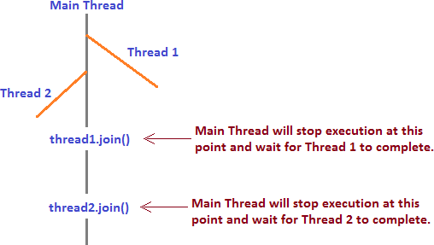
Thread Methods: The join() Method
join() method is used for waiting the thread in execution until the thread on which join is called is not completed. Remember, the thread which will wait is the thread in execution and it will wait until the thread on which join method called is not completed.
You can use the join() method to force one thread to wait for another thread to finish.
Syntax:
final void join( ) throws InterruptedException
Threadwithoutjoin.java
Threadjoin.java

Slide 31
Thread Methods: deprecated: stop(), suspend(), and resume() Methods
Whenever we want to stop a thread from running state by calling stop() method of Thread class in Java. This method stops the execution of a running thread and removes it from the waiting threads pool and garbage collected. A thread will also move to the dead state automatically when it reaches the end of its method. The stop() method is deprecated in Java due to thread-safety issues.
Syntax:
public final void stop()
The suspend() method of thread class puts the thread from running to waiting state. This method isused if you want to stop the thread execution and start it again when a certain event occurs.
Syntax:
public final void suspend()
The resume() method of thread class is only used with suspend() method. This method is used to resume a thread which was suspended using suspend() method. This method allows the suspended thread to start again.
Syntax:
public final void resume()

Slide 32
Scenario: Develop a Java program to create three concurrent tasks named “One”, “Two”, and “Three”.Each task should execute in its own thread, display a countdown from 5 to 1 with a one-second delay between each value, and then terminate. The main thread should continue execution independently and display a message before exiting.
class NewThread implements Runnable {
String name; // name of thread
Thread t;
NewThread(String threadname) {
name = threadname;
t = new Thread(this, name);
System.out.println("New thread: " + t);
t.start(); // Start the thread
}

Slide 33
// Entry point for the thread
public void run() {
try {
for (int i = 5; i > 0; i--) {
System.out.println(name + ": " + i);
Thread.sleep(1000);
}
} catch (InterruptedException e) {
System.out.println(name + " interrupted.");
}
System.out.println(name + " exiting.");
}
}

Slide 34
class MultiThreadDemo {
public static void main(String args[]) {
new NewThread("One");
new NewThread("Two");
new NewThread("Three");
try {
Thread.sleep(10000);
} catch (InterruptedException e) {
System.out.println("Main thread interrupted.");
}
System.out.println("Main thread exiting.");
}
}

Slide 35
Output:
New thread: Thread[One,5,main]
New thread: Thread[Two,5,main]
New thread: Thread[Three,5,main]
One: 5
Two: 5
Three: 5
One: 4
Three: 4
Two: 4
...
One exiting.
Two exiting.
Three exiting.
Main thread exiting.

Slide 36
Session 4: Thread Priorities

Slide 37
Thread Priorities:
Thread priority in Java is a mechanism used by the JVM to decide the order in which multiple threads are scheduled for execution.
Each thread is assigned a priority value that indicates its relative importance compared to other threads.
Java follows a priority-based, preemptive scheduling model. The priority value ranges from 1 to 10, where a higher number represents a higher priority.
By default, every thread is assigned a normal priority (5).
It is important to note that thread priority acts only as a suggestion to the JVM, and the actual execution order depends on the underlying operating system and JVM implementation.

Slide 38
Each thread is assigned a default priority of Thread.NORM_PRIORITY (constant of 5).
Java provides predefined constants in the Thread class to manage thread priorities: MIN_PRIORITY (1), NORM_PRIORITY (5), and MAX_PRIORITY (10).
MIN_PRIORITY (1) → Least important task
NORM_PRIORITY (5) → Default importance
MAX_PRIORITY (10) → Most important task
The priority of a thread can be set using the setPriority(int priority) method and retrieved using the getPriority() method.
Some static integral constants for priorities included in Thread Class:
Example: MIN_PRIORITY+1, MAX_PRIORITY-5
By default, a thread has the priority level of the thread that created it.

Slide 39
Syntax:
threadObject.setPriority(Thread.MAX_PRIORITY);
int p = threadObject.getPriority();
Problem Statement:
Design and implement a Java program to demonstrate multithreading using thread priorities. Create multiple threads representing different system tasks and assign them minimum, normal, and maximum priorities using the constants of the Thread class. The program should use the isAlive() method to check whether each thread is still executing and the join() method to make the main thread wait until all child threads complete execution. The output should clearly illustrate concurrent execution, priority-based scheduling behavior.

Slide 40
class NewThread implements Runnable {
String name;
Thread t;
NewThread(String threadname, int priority) {
name = threadname;
t = new Thread(this, name);
t.setPriority(priority); // Set thread priority
System.out.println("New thread created: " + t);
t.start(); // Start thread
} //End of Constructor

Slide 41
// Entry point for thread
public void run() {
try {
for (int i = 5; i > 0; i--) {
System.out.println(name + ": " + i);
Thread.sleep(1000);
}
} catch (InterruptedException e) {
System.out.println(name + " interrupted.");
}
System.out.println(name + " exiting.");
}
}

Slide 42
class MultiThreadDemo {
public static void main(String args[]) {
// Creating threads with different priorities
NewThread t1 = new NewThread("One", Thread.MIN_PRIORITY);
NewThread t2 = new NewThread("Two", Thread.NORM_PRIORITY);
NewThread t3 = new NewThread("Three", Thread.MAX_PRIORITY);
// Checking whether threads are alive
System.out.println("Thread One alive: " + t1.t.isAlive());
System.out.println("Thread Two alive: " + t2.t.isAlive());
System.out.println("Thread Three alive: " + t3.t.isAlive());

Slide 43
try {
t1.t.join(); // Main thread waits for child threads to finish
t2.t.join();
t3.t.join();
} catch (InterruptedException e) {
System.out.println("Main thread interrupted.");
}
System.out.println("Thread One alive: " + t1.t.isAlive()); // Checking thread status after completion
System.out.println("Thread Two alive: " + t2.t.isAlive());
System.out.println("Thread Three alive: " + t3.t.isAlive());
System.out.println("Main thread exiting.");
}
}

Slide 44
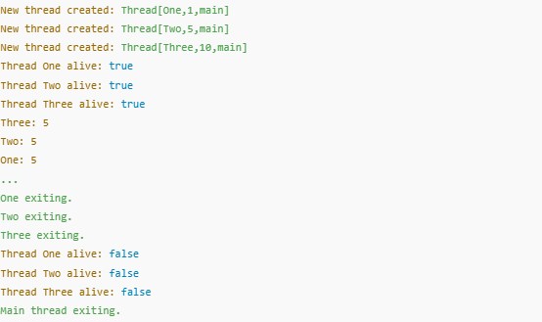
Expected Output:

Slide 45
Session 5: Synchronization

Slide 46
Synchronization:
When several threads need access to a shared resource, they need some way to ensure that the resource will be used by only one thread at a time.
This way is called synchronization. Synchronization uses the concept of monitors:
only one thread can enter a monitor at any one time
other threads have to wait until the threat exits the monitor
Java implements synchronization in two ways: through the synchronized methods and through the synchronized statement.

Slide 47
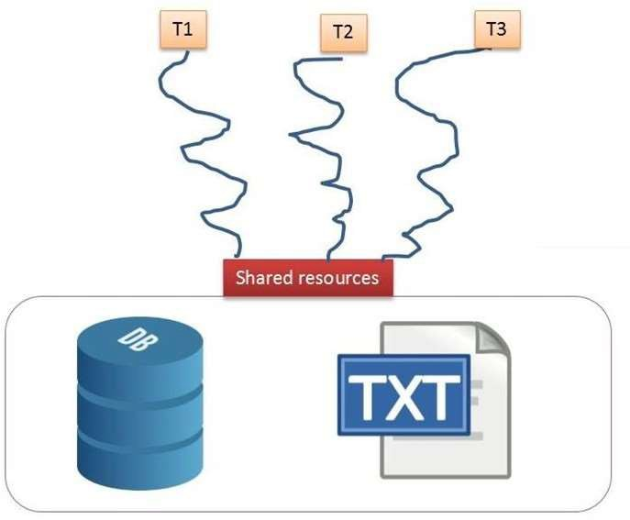
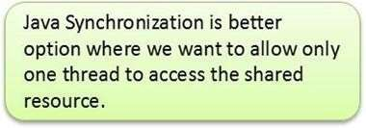
Thread Synchronization
threadnonsync.java
In Java, the threads are executed independently to each other. These types of threads are called as asynchronous threads. But there are two problems may be occur with asynchronous threads.
Two or more threads share the same resource (variable or method) while only one of them can access the resource at one time.
Race Condition
Resource Conflict

Slide 48
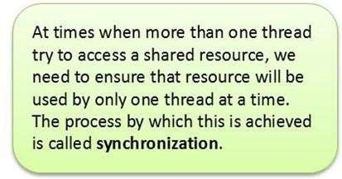

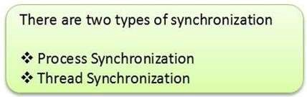
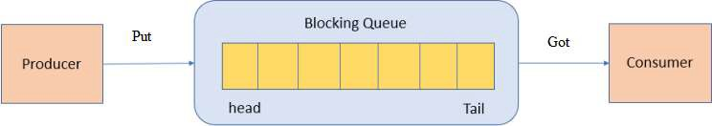
Thread Synchronization
If the producer and the consumer are sharing the same kind of data in a program then either producer may produce the data faster or consumer may retrieve an order of data and process it without its existing.
Producer Consumer Problem

Slide 49
Thread Synchronization
threadsyncB.java threadsyncM.java
There are two ways to synchronized the execution of code:
Synchronized Methods
Synchronized Blocks (Statements)
General form of synchronized Method is:
General form of synchronized block is:
synchronized returntype MethodName (param_List)
{
// statements in the method Body
}
synchronized (object reference expression)
{
// statements to be synchronized
}

Slide 50
Synchronized Method:
All objects have their own implicit monitor associated with them.
To enter an object’s monitor, call this object’s synchronized method.
While a thread is inside monitor, all threads that try to call this or any other synchronized method on this object have to wait.
To exit the monitor, it is enough to return from the synchronized method.
Consider first an example without synchronization…

Slide 51
Example: No Synchronization 1
The call method tries to print the message string inside brackets, pausing the current thread for one second in the middle:
class Callme {
void call(String msg) {
System.out.print("[" + msg); try {
Thread.sleep(1000);
} catch(InterruptedException e) { System.out.println("Interrupted");
}
System.out.println("]");
}
}

Slide 52
Example: No Synchronization 2
Caller constructor obtains references to the Callme object and String, stores them in the target and msg variables, then creates a new thread:
class Caller implements Runnable { String msg;
Callme target; Thread t;
public Caller(Callme targ, String s) { target = targ;
msg = s;
t = new Thread(this); t.start();
}

Slide 53
Example: No Synchronization 3
The Caller’s run method calls the call method on the target instance of
Calllme, passing in the msg string:
public void run() { target.call(msg);
}
}

Slide 54
Example: No Synchronization 4
Synch class creates a single instance of Callme and three of Caller, each with a message. The Callme instance is passed to each Caller:
class Synch {
public static void main(String args[]) {
Callme | target = new Callme();
Caller | ob1 = new Caller(target, | "Hello");
Caller | ob2 = new Caller(target, | "Synchronized");
Caller | ob3 = new Caller(target, | "World");

Slide 55
Example: No Synchronization 5
Waiting for all three threads to finish:
try {
ob1.t.join();
ob2.t.join();
ob3.t.join();
} catch(InterruptedException e) { System.out.println("Interrupted");
}
}
}

Slide 56
No Synchronization
Output from the earlier program:
[Hello[Synchronized[World]
]
]
By pausing for one second, the call method allows execution to switch to another thread. A mix-up of the outputs from of the three message strings.
In this program, nothing exists to stop all three threads from calling the same method on the same object at the same time.

Slide 57
Synchronized Method
To fix the earlier program, we must serialize the access to call:
class Callme {
synchronized void call(String msg) {
…
}
}
This prevents other threads from entering call while another thread is using it. The output result of the program is now as follows:
[Hello] [Synchronized] [World]

Slide 58
Synchronized Statement
How to synchronize access to instances of a class that was not designed for multithreading and we have no access to its source code?
Put calls to the methods of this class inside the synchronized block:
synchronized(object) {
…
}
This ensures that a call to a method that is a member of the object occurs only after the current thread has successfully entered the object’s monitor.

Slide 59
Example: Synchronized 1
Now the call method is not modified by synchronized:
class Callme {
void call(String msg) { System.out.print("[" + msg); try {
Thread.sleep(1000);
} catch (InterruptedException e) { System.out.println("Interrupted");
}
System.out.println("]");
}
}

Slide 60
Example: Synchronized 2
class Caller implements Runnable { String msg;
Callme target; Thread t;
public Caller(Callme targ, String s) { target = targ;
msg = s;
t = new Thread(this); t.start();
}

Slide 61
Example: Synchronized 3
The Caller’s run method uses the synchronized statement to include the call the target’s call method:
public void run() { synchronized(target) {
target.call(msg);
}
}
}

Slide 62
Example: Synchronized 4
class Synch1 {
public static void main(String args[]) {
Callme | target = new Callme();
Caller | ob1 = new Caller(target, | "Hello");
Caller | ob2 = new Caller(target, | "Synchronized");
Caller | ob3 = new Caller(target, | "World");
try {
ob1.t.join();
ob2.t.join();
ob3.t.join();
} catch(InterruptedException e) { System.out.println("Interrupted");
}
}
}

Slide 63
Session 6: Inter Thread Communication

Slide 64
Inter-Thread Communication
Inter-thread communication relies on three methods in the Object class:
final void wait() throws InterruptedException
tells the calling thread to give up the monitor and go to sleep until some other thread enters the same monitor and calls notify().
final void notify()
wakes up the first thread that called wait() on the same object
final void notifyAll()
wakes up all the threads that called wait() on the same object; the highest-priority thread will run first.
All three must be called from within a synchronized context.

Slide 65
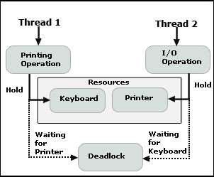
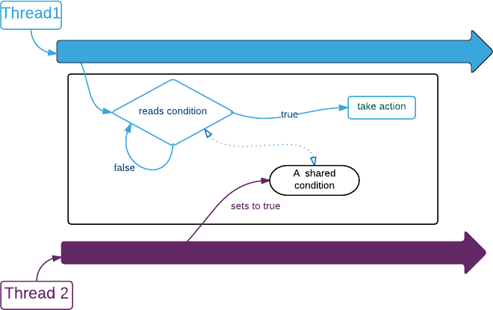
Inter-thread communication
threadInterNonCom.java
AFTER SYNCHRONIZATION
Problem: DeadLock
Solution: Inter-Thread Communication

Slide 66
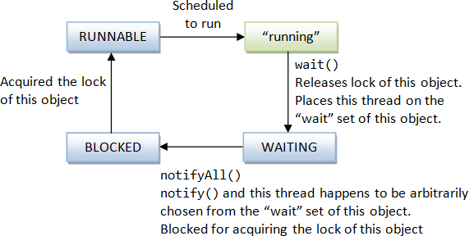
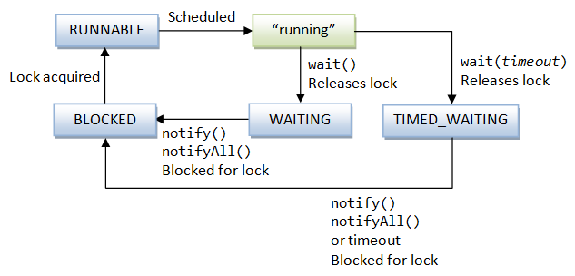
Inter-thread communication
wait(), notify() & notifyAll()
wait() with timeout

Slide 67
Inter-thread communication
threadInterCom.java
Java provide benefits of avoiding thread pooling using inter-thread communication. The wait(), notify(), and notifyAll() methods of Object class are used for this purpose. These method are implemented as final methods in Object, so that all classes have them. All the three method can be called only from within a synchronized context.
wait() tells calling thread to give up monitor and go to sleep until some other thread enters the same monitor and call notify.
notify() wakes up a thread that called wait() on same object.
notifyAll() wakes up all the thread that called wait() on same object.
These methods are declared within Object, as shown here:
final void wait( ) throws InterruptedException
final void notify( )
final void notifyAll( )
Producer Consumer Problem

Slide 68
Queuing Problem
Consider the classic queuing problem where one thread (producer) is producing some data and another (consumer) is consuming this data:
producer should not overrun the consumer with data
consumer should not consume the same data many times
We consider two solutions:
  incorrect with synchronized only
  correct with synchronized and wait/notify

Slide 69
Example: Incorrect Queue 1
The one-place queue class Q, with the variable n and methods get and
put. Both methods are synchronized:
class Q { int n;
synchronized int get() { System.out.println("Got: " + n); return n;
}
synchronized void put(int n) { this.n = n; System.out.println("Put: " + n);
}
}

Slide 70
Example: Incorrect Queue 2
Producer creates a thread that keeps producing entries for the queue:
class Producer implements Runnable { Q q;
Producer(Q q) { this.q = q;
new Thread(this, "Producer").start();
}
public void run() { int i = 0; while(true) {
q.put(i++);
}
}
}

Slide 71
Example: Incorrect Queue 3
Consumer creates a thread that keeps consuming entries in the queue:
class Consumer implements Runnable { Q q;
Consumer(Q q) { this.q = q;
new Thread(this, "Consumer").start();
}
public void run() { while(true) {
q.get();
}
}
}

Slide 72
Example: Incorrect Queue 4
The PC class first creates a single Queue instance q, then creates a
Producer and Consumer that share this q:
class PC {
public static void main(String args[]) { Q q = new Q();
new Producer(q); new Consumer(q);
System.out.println("Press Control-C to stop.");
}
}

Slide 73
Why Incorrect?
Here is the output:
Put: | 1
Got: | 1
Got: | 1
Put: | 2
Put: | 3
Get: | 3
…
Nothing stops the producer from overrunning the consumer, nor the consumer from consuming the same data twice.

Slide 74
Example: Corrected Queue 1
The correct producer-consumer system uses wait and notify to synchronize the behavior of the producer and consumer.
The queue class introduces the additional boolean variable valueSet
used by the get and put methods:
class Q { int n;
boolean valueSet = false;

Slide 75
Example: Corrected Queue 2
Inside get, wait is called to suspend the execution of Consumer until
Producer notifies that some data is ready:
synchronized int get() { if (!valueSet)
try {
wait();
}
catch(InterruptedException e) { System.out.println("InterruptedException");
}

Slide 76
Example: Corrected Queue 3
After the data has been obtained, get calls notify to tell Producer that it can put more data on the queue:
System.out.println("Got: " + n);
valueSet = false;
notify(); return n;
}

Slide 77
Example: Corrected Queue 4
Inside put, wait is called to suspend the execution of Producer until
Consumer has removed the item from the queue:
synchronized void put(int n) { if (valueSet)
try {
wait();
} catch(InterruptedException e) { System.out.println("InterruptedException");
}

Slide 78
Example: Corrected Queue 5
After the next item of data is put in the queue, put calls notify to tell
Consumer that it can remove this item:
this.n = n; valueSet = true;
System.out.println("Put: " + n); notify();
}
}

Slide 79
Example: Corrected Queue 6
Producer creates a thread that keeps producing entries for the queue:
class Producer implements Runnable { Q q;
Producer(Q q) { this.q = q;
new Thread(this, "Producer").start();
}
public void run() { int i = 0; while(true) {
q.put(i++);
}
}
}

Slide 80
Example: Corrected Queue 7
Consumer creates a thread that keeps consuming entries in the queue:
class Consumer implements Runnable { Q q;
Consumer(Q q) { this.q = q;
new Thread(this, "Consumer").start();
}
public void run() { while(true) {
q.get();
}
}
}

Slide 81
Example: Corrected Queue 8
The PCFixed class first creates a single Queue instance q, then creates a
Producer and Consumer that share this q:
class PCFixed {
public static void main(String args[]) { Q q = new Q();
new Producer(q); new Consumer(q);
System.out.println("Press Control-C to stop.");
}
}

Slide 82
Session 7: Deadlock

Slide 83
Deadlock
Multi-threading and synchronization create the danger of deadlock.
Deadlock: a circular dependency on a pair of synchronized objects. Suppose that:
one thread enters the monitor on object X
another thread enters the monitor on object Y
the first thread tries to call a synchronized method on object Y
the second thread tries to call a synchronized method on object X
The result: the threads wait forever – deadlock.

Slide 84
Example: Deadlock 1
Class A contains the foo method which takes an instance b of class B as a parameter. It pauses briefly before trying to call the b’s last method:
class A {
synchronized void foo(B b) {
String name = Thread.currentThread().getName(); System.out.println(name + " entered A.foo"); try {
Thread.sleep(1000);
} catch(Exception e) { System.out.println("A Interrupted");
}
System.out.println(name + " trying B.last()"); b.last();
}

Slide 85
Example: Deadlock 2
Class A also contains the synchronized method last:
synchronized void last() { System.out.println("Inside A.last");
}
}

Slide 86
Example: Deadlock 3
Class B contains the bar method which takes an instance a of class A as a parameter. It pauses briefly before trying to call the a’s last method:
class B {
synchronized void bar(A a) {
String name = Thread.currentThread().getName(); System.out.println(name + " entered B.bar"); try {
Thread.sleep(1000);
} catch(Exception e) { System.out.println("B Interrupted");
}
System.out.println(name + " trying A.last()"); a.last();
}

Slide 87
Example: Deadlock 4
Class B also contains the synchronized method last:
synchronized void last() { System.out.println("Inside A.last");
}
}

Slide 88
Example: Deadlock 5
The main Deadlock class creates the instances a of A and b of B:
class Deadlock implements Runnable {
A a = new A();
B b = new B();

Slide 89
Example: Deadlock 6
The constructor creates and starts a new thread, and creates a lock on the a
object in the main thread (running foo on a) with b passed as a parameter:
Deadlock() { Thread.currentThread().setName("MainThread"); Thread t = new Thread(this, "RacingThread"); t.start();
a.foo(b);
System.out.println("Back in main thread");
}

Slide 90
Example: Deadlock 7
The run method creates a lock on the b object in the new thread (running
bar on b) with a passed as a parameter:
public void run() { b.bar(a);
System.out.println("Back in other thread");
}
Create a new Deadlock instance:
public static void main(String args[]) { new Deadlock();
}
}

Slide 91
Deadlock Reached
Program output:
MainThread entered A.foo RacingThread entered B.bar MainThread trying to call B.last() RacingThread trying to call A.last()
RacingThread owns the monitor on b while waiting for the monitor on a. MainThread owns the monitor on a while it is waiting for the monitor on b.
The program deadlocks!

Slide 92
Session 8: Executor Framework

Slide 93
Executor Framework
With the traditional approach of thread creation, When we create a new thread for executing a new task cause overhead of thread creation, In order to manage this thread life-cycle, the execution time increase respectively.
Java has flexible thread pool implementation, called the Executor framework.
A framework having a bunch of components that are used for managing worker threads efficiently is referred to as Executor Framework.
The Executor API reduces the execution of the task from the actual task to be executed through the Executors.
The executor framework is an implementation of the Producer-Consumer pattern. The java.util.concurrent.Executors class provides a set of methods for creating ThreadPools of worker threads.
Required for efficient Java multithreading.

Slide 94
Executor Framework
public interface Executor {
void execute(Runnable command) ;
}
Based on producer/consumer pattern
Producers submit tasks and consumers consume tasks
Decouples task submission from task execution

Slide 95
Executor Framework
Based on producer/consumer pattern
Decouples task submission from task execution
The value of decoupling task submission from execution allows us to easily change the execution policy
An execution policy specifies :
In what thread a task will execute
In what order tasks will be executed
How many tasks may execute concurrently
How many tasks may be pending
Which tasks to reject if the system is overloaded

Slide 96
Inter Thread Communication (contd…)
Producer Consumer Problem
In computing, the producer-consumer problem (also known as the bounded-buffer problem) is a classic example of a multi-process synchronization problem. The problem describes two processes, the producer and the consumer, which share a common, fixed-size buffer used as a queue.
  The producer’s job is to generate data, put it into the buffer, and start again.
  At the same time, the consumer is consuming the data (i.e. removing it from the buffer), one piece at a time.

